Slide 1
Chapter 1
Overview of E-commerce

Slide 2
Table of contents
What is E-commerce?
Why study E-commerce?
Features of E-commerce
Types of E-commerce
Web 2.0
Evolution of E-commerce
Slide 1-<number>

Slide 3
Table of contents
What is E-commerce?
Why study E-commerce?
Features of E-commerce
Types of E-commerce
Web 2.0
Evolution of E-commerce
Slide 1-<number>

Slide 4
What Is E-commerce?
Use of Internet and Web or Mobile apps to transact business
More formally:
  Digitally enabled commercial transactions between and among organizations and individuals
Slide 1-<number>

Slide 5
What is E-commerce?
E-commerce vs. E-business
E-business:
  Digital enabling of transactions and processes within a firm, involving information systems under firm’s control
  Does not include commercial transactions involving an exchange of value across organizational boundaries
Slide 1-<number>

Slide 6
Table of contents
What is E-commerce?
Why study E-commerce?
Features of E-commerce
Types of E-commerce
Web 2.0
Evolution of E-commerce
Slide 1-<number>

Slide 7
Table of contents
What is E-commerce?
Why study E-commerce?
Features of E-commerce
Types of E-commerce
Web 2.0
Evolution of E-commerce
Slide 1-<number>

Slide 8
Why Study E-commerce?
E-commerce technology is different, more powerful than previous technologies
E-commerce brings fundamental changes to commerce
Traditional commerce:
  Consumer as passive targets
  Mass-marketing driven
  Sales-force driven
  Fixed prices
  Information asymmetry
Slide 1-<number>

Slide 9
Table of contents
What is E-commerce?
Why study E-commerce?
Features of E-commerce
Types of E-commerce
Web 2.0
Evolution of E-commerce
Slide 1-<number>

Slide 10
Table of contents
What is E-commerce?
Why study E-commerce?
Features of E-commerce
Types of E-commerce
Web 2.0
Evolution of E-commerce
Slide 1-<number>

Slide 11
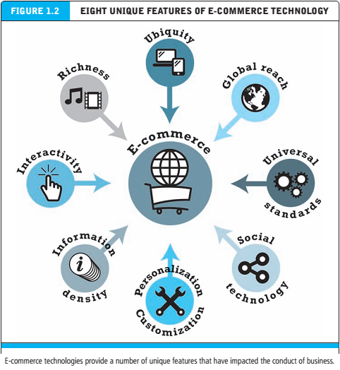
Slide 1-<number>

Slide 12
Eight Unique Features of
E-commerce Technology
Ubiquity
Global reach
Universal standards
Information richness
Interactivity
Information density
Personalization/customization
Social technology
Slide 1-<number>

Slide 13
Eight Unique Features of
E-commerce Technology
Ubiquity :
available just about everywhere,
at all times
Slide 1-<number>

Slide 14
Eight Unique Features of
E-commerce Technology
Global reach
Reach: The total number of users or customers an e-commerce business can obtain
Traditional commerce: local/regional reach
E-commerce: global reach
Slide 1-<number>

Slide 15
Eight Unique Features of
E-commerce Technology
Universal standards
standards that are shared by all nations around the world
  Lowers market entry cost, enables easy price discovery, and network externalities benefit consumers because everyone uses the same technology
Slide 1-<number>

Slide 16
Eight Unique Features of
E-commerce Technology
Richness:
the complexity and content of a message
Traditional commerce: great richness, powerful commercial environment
E-commerce: trade-off between richness and reach, but still powerful thanks to the Internet
Slide 1-<number>

Slide 17
Eight Unique Features of
E-commerce Technology
Interactivity:
technology that allows for two-way communication between merchant and consumer
Slide 1-<number>

Slide 18
Eight Unique Features of
E-commerce Technology
Information Density:
the total amount and quality of information available to all market participants
Slide 1-<number>

Slide 19
Eight Unique Features of
E-commerce Technology
Personalization/Customization:
Personalization: adjusting the message to a person’s name, interests, past purchases…
Customization: changing the delivered product based on a user’s behavior
Slide 1-<number>

Slide 20
Eight Unique Features of
E-commerce Technology
Social technology:
user content generation and
social networking
Slide 1-<number>

Slide 21
Table of contents
What is E-commerce?
Why study E-commerce?
Features of E-commerce
Types of E-commerce
Web 2.0
Evolution of E-commerce
Slide 1-<number>

Slide 22
Table of contents
What is E-commerce?
Why study E-commerce?
Features of E-commerce
Types of E-commerce
Web 2.0
Evolution of E-commerce
Slide 1-<number>

Slide 23
Types of E-commerce
    May be classified by market relationship or technology
Business-to-Consumer (B2C)
Business-to-Business (B2B)
Consumer-to-Consumer (C2C)
Social e-commerce
Mobile e-commerce (M-commerce)
Local e-commerce
Slide 1-<number>

Slide 24
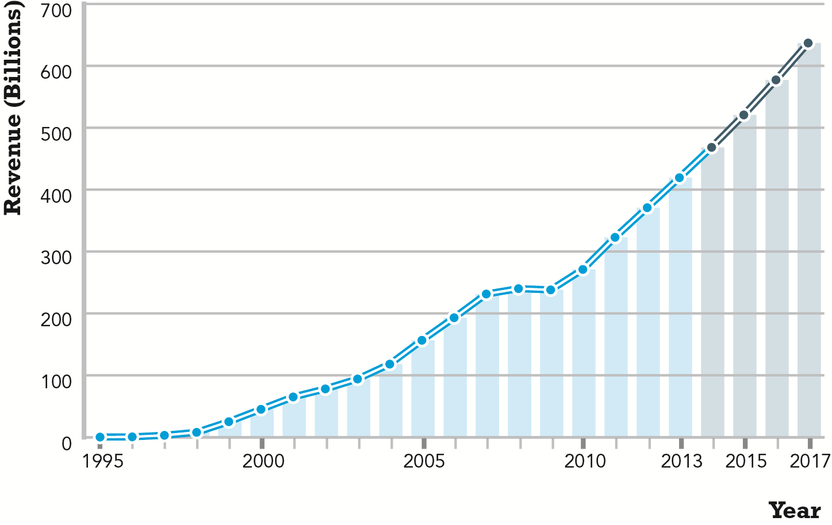
The Growth of B2C E-commerce
Figure 1.3, Page 20
SOURCE: Based on data from eMarketer, Inc., 2013a; authors’ estimates.
Slide 1-<number>

Slide 25
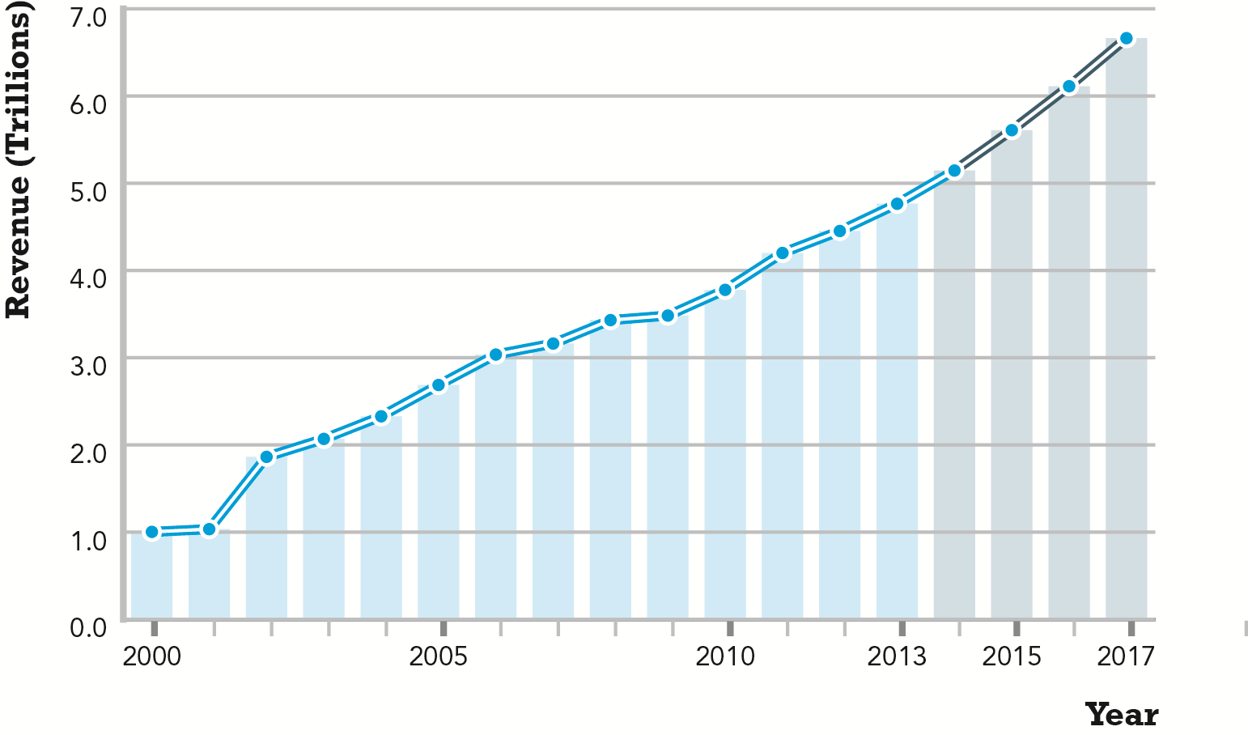
The Growth of B2B E-commerce
Figure 1.4, Page 21
SOURCE: Based on data from U.S. Census Bureau, 2013; authors’ estimates.
Slide 1-<number>

Slide 26
Table of contents
What is E-commerce?
Why study E-commerce?
Features of E-commerce
Types of E-commerce
Web 2.0
Evolution of E-commerce
Slide 1-<number>

Slide 27
Table of contents
What is E-commerce?
Why study E-commerce?
Features of E-commerce
Types of E-commerce
Web 2.0
Evolution of E-commerce
Slide 1-<number>

Slide 28
The Internet
Worldwide network of computer networks built on common standards
Created in late 1960s
Services include the Web, e-mail, file transfers, and so on
Can measure growth by number of Internet hosts with domain names
Slide 1-<number>

Slide 29
The Web
Most popular Internet service
Developed in early 1990s
Provides access to Web pages
  HTML documents that may include text, graphics, animations, music, videos
Web content has grown exponentially
  Google reports 30 trillion unique URLs; 120 billion Web pages indexed
Slide 1-<number>

Slide 30
The Mobile Platform
Most recent development in Internet infrastructure
Enables access to the Internet via wireless networks or cell-phone service
Mobile devices include
  Tablets
  Smartphones
  Ultra-lightweight laptops
Slide 1-<number>

Slide 31
Web 2.0
User-centered applications/websites and social media technologies
  User-generated content and communication
  Highly interactive, social communities
  Large audiences; yet mostly unproven business models
  Examples: Twitter, YouTube, Instagram, Wikipedia, Tumblr
Slide 1-<number>

Slide 32
Will Apps Make the Web Irrelevant?
What are the advantages and disadvantages of apps, compared with Web sites, for mobile users?
What are the benefits of apps for content owners and creators?
Will apps eventually make the Web irrelevant? Why or why not?
Slide 1-<number>

Slide 33
Table of contents
What is E-commerce?
Why study E-commerce?
Features of E-commerce
Types of E-commerce
Web 2.0
Evolution of E-commerce
Slide 1-<number>

Slide 34
Table of contents
What is E-commerce?
Why study E-commerce?
Features of E-commerce
Types of E-commerce
Web 2.0
Evolution of E-commerce
Slide 1-<number>

Slide 35
Evolution of E-commerce
1995–2000: Invention
  Key concepts developed
  Limited bandwidth and media
  Euphoric visions of
    Friction-free commerce
      Lowered search costs, disintermediation, price transparency, elimination of unfair competitive advantage
    First-mover advantages
      Network profits
  Dot-com crash of 2000
Slide 1-<number>

Slide 36
Evolution of E-commerce (cont.)
2001–2006: Consolidation
  Emphasis on business-driven approach
  Traditional large firms expand presence
  More complex products and services sold
  Growth of search engine advertising
  Business Web presences expand to include e-mail, display and search advertising, and limited community feedback features
Slide 1-<number>

Slide 37
Evolution of E-commerce (cont.)
2007–Present: Reinvention
  Rapid growth of:
    Online social networks
    Mobile platform
    Local commerce
  Entertainment content develops as source of revenues
  Transformation of marketing
    Coordinated marketing on social, mobile, local platforms
    Analytic technologies
Slide 1-<number>

Slide 38
Start-up Boot Camp
Y Combinator: Silicon Valley best-known incubator
Twice a year, a three-month boot camp is provided
Admitted companies: money, supports
Y Combinator’s biggest success: Dropbox
Slide 1-<number>

Slide 39
Start-up Boot Camp
Why do you think investors today are still interested in investing in start-ups?
What are the benefits of investing in a company that is a graduate of a Y Combinator boot camp?
Is an incubator the best solution for start-ups to find funding? Why or why not?
Slide 1-<number>

Slide 40
Facebook and the Age of Privacy
Viewpoint: The “age of privacy” had come to an end, an “information exhibitionism” is coming.
More than 2 billion users worldwide
2009: publish user’s information, claim that everything would belong to Facebook permanently; “Like” button introduced.
2010: “Like” from third-party websites, alert friends to know what has been liked
Slide 1-<number>

Slide 41
Facebook and the Age of Privacy
2011: public user’s name and profile picture on sponsored advertisements; enroll all users into facial recognition.
2012: tag suggestion, push ads to mobile news feeds
2013: hashtags
Slide 1-<number>

Slide 42
Facebook and the Age of Privacy
Why are social network sites interested in collecting user information?
How do you protect your privacy on the Web?
Slide 1-<number>

Slide 43
The end
Slide 1-<number>

